Slide 1
Homework Louisiana
Full product training
With promotional calendar

Slide 2
three major components
FLI: For Librarians’ Information
Real-Time Tutoring
3,000+ expert tutors
On-demand, 2pm-10pm,
Sun-Thu
Job Seeker 10am-10pm
40+ subjects
Asynchronous Reviews
Essays/Writing
Resumes/Cover Letters
Math Questions
Algebra through Calculus
Self-Study Tools
SAT/ACT Essentials
SkillsCenter™
Practice Quizzes
www.tutor.com/clientcarelib/la
2

Slide 3
Tutoring subjects available
Math* | Science* | Social Studies* | Languages | Writing | Test Prep | Computer & Job
Basic I & II | Basic | History | English | Book Reports | AP® Test | Job Searches
Algebra I & II | Earth Science | Government | -Grammar | Creative Writing | PSAT® | Applications
Geometry | Biology | Geography | -Literature | Essays | ACT® | Cover Letters
Trigonometry | Chemistry | Political Science | -Vocabulary | General Technique | SAT® | Résumés
Pre- & Calculus | Physics |  | Reading Comp. | Letters | HSE/TASC | Interview Prep
Statistics |  |  | ESL/ELL | Research Papers | Citizenship | MS Word®
 |  |  | Spanish | Short Stories |  | MS Excel®
 |  |  |  |  |  | MS PowerPoint®
*Bilingual Spanish speaking tutors available
FLI: For Librarians’ Information
www.tutor.com/clientcarelib/la
3

Slide 4
OUR TUTORS
Tutoring Session
Student Feedback
Automated Reviews
Manual Reviews
Mentor Evaluation
7%
Subject Matter Exams
25%
Mock Session
81%
Background Check
Advancement Opportunities
95% Job Satisfaction
FLI: For Librarians’ Information
Sharable Resources
10 Things Teachers Should Know
10 Things Parents Should Know
Safe & Secure Assurance
http://go.tutor.com/libraries/hcl
www.tutor.com/clientcarelib/la
4

Slide 5
Patron Experience
Point links to homeworkla.org
Authenticate through GeoIP or LaLibCon login
www.tutor.com/clientcarelib/la
5

Slide 6
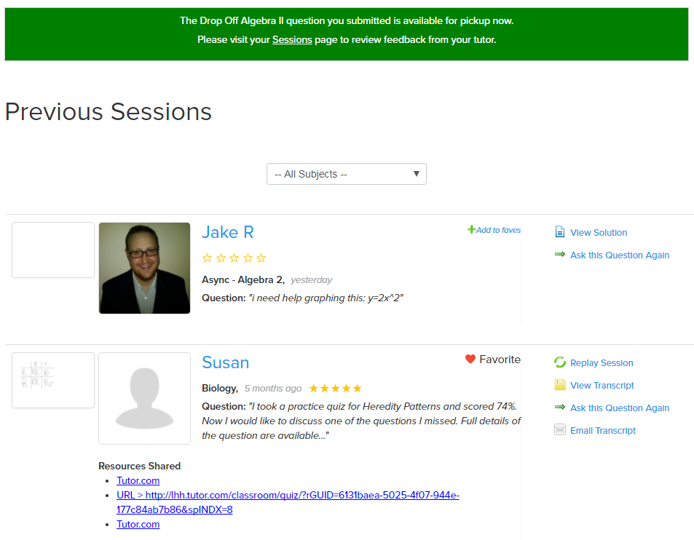
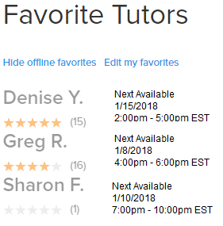
Patron Experience
Tutor.com Account Features
Previous Sessions
Drop-off Review Retrieval
Favorite Tutors
Virtual Locker
COPPA Compliant
www.tutor.com/clientcarelib/la
6

Slide 7
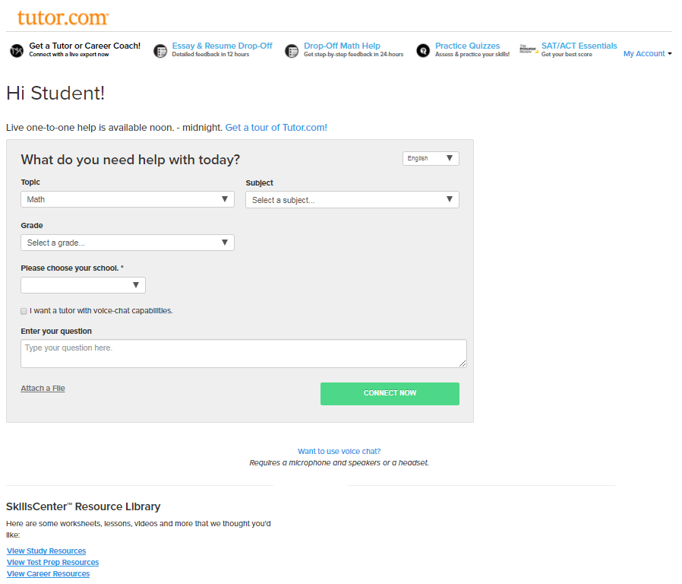
Patron Experience
Tutor.com Entry Page
Top Navigation Bar
My Account Menu
Defaults to “Get a Tutor”
SkillsCenter™ at Bottom
Changing in early 2018
www.tutor.com/clientcarelib/la
7

Slide 8
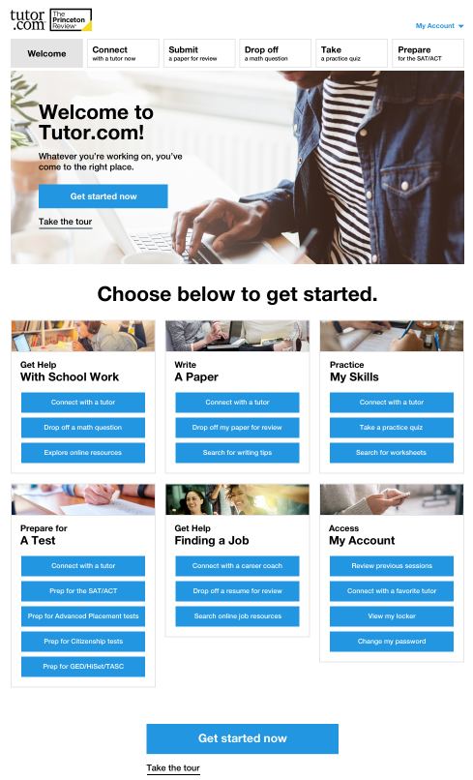
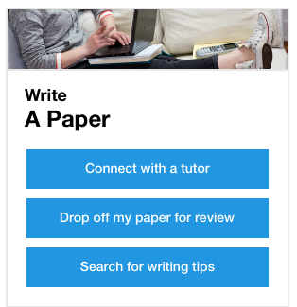
Coming in 2018 New Landing Page
Improved ‘merchandising’
Customizable navigation
Bolder, brighter display
www.tutor.com/clientcarelib/la
8

Slide 9
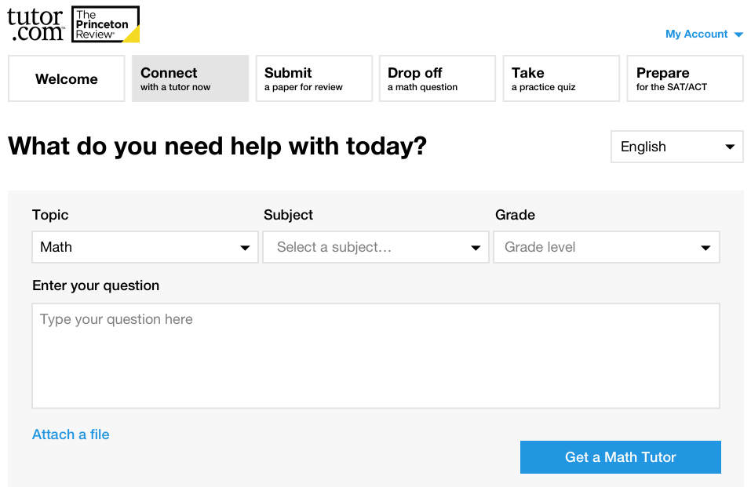
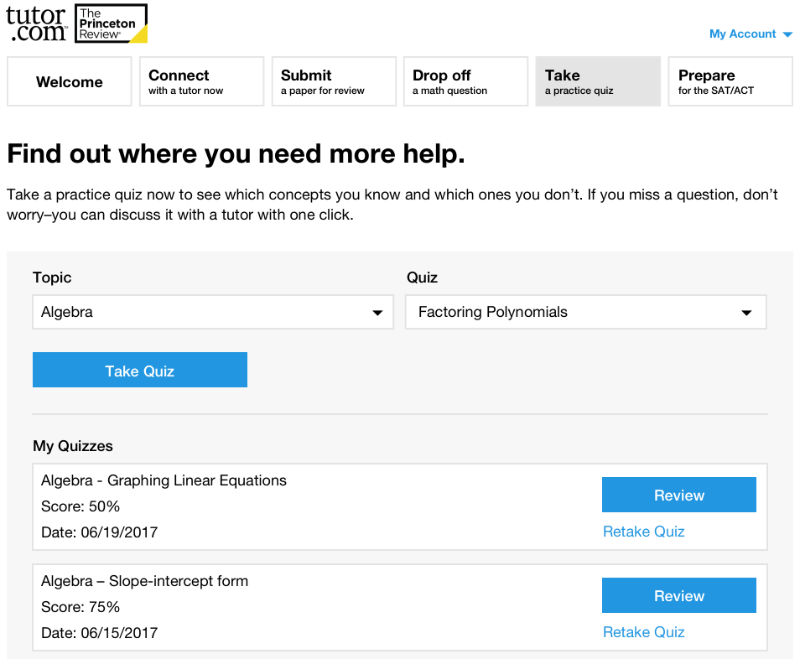
Coming in 2018 New Look & Feel
www.tutor.com/clientcarelib/la
9

Slide 10
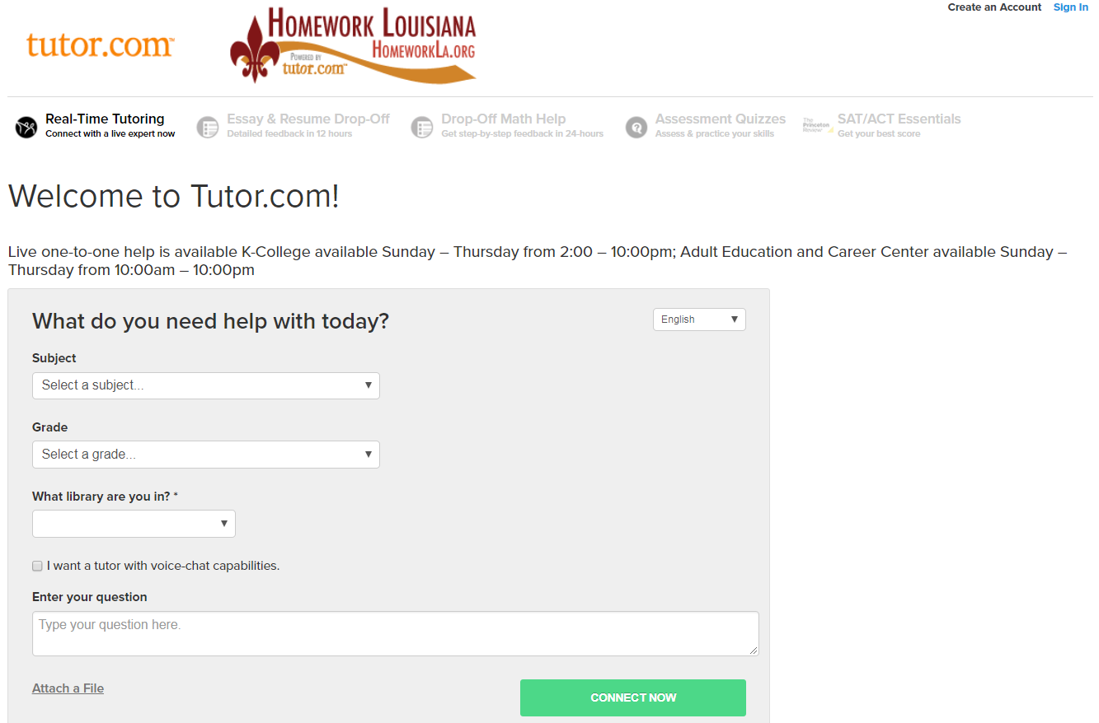
Patron Experience
Get a Tutor or Career Coach
K-12th + intro-college
Adult Learners
Job Seekers
Homework Help
Skills Building
Remedial Tutoring
Test Preparation
WriteTutor Coaching
Job Search Assistance
www.tutor.com/clientcarelib/la
10

Slide 11
Example questions
Subject | Student Question
SAT Prep: Writing | “I am doing the Identifying Sentence Errors portion of a SAT Practice Worksheet, and I need some help with some of the questions.”
ESL for ELL | Past versus Passed
Microsoft Office® | “how to use excel to create a chart”
Reading Comprehension | “What type of constituent is underlined in the sentence below? The nice unicorns from that planet are visiting us regularly. “
Job Search Help | “Hello. can you help me reword my experiences and job descriptions to tailor it to the position in which i am seeking employment? i will send you my resume with no personal info. “
GED/HiSET/TASC Prep | “Trying to earn my GED, I need help with the Bill Of Rights. I need help on remembering 10 armaments.”
Matematicas Primeria | “Nesecito ayuda con matematicas leccion 1.9 y 1.10”
FLI: For Librarians’ Information
www.tutor.com/clientcarelib/la
11

Slide 12
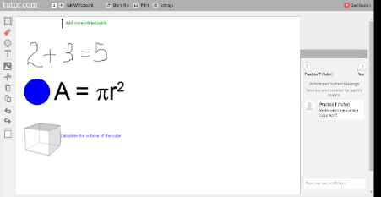
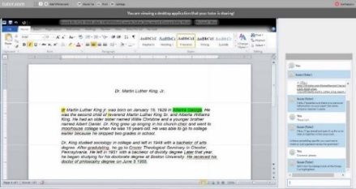
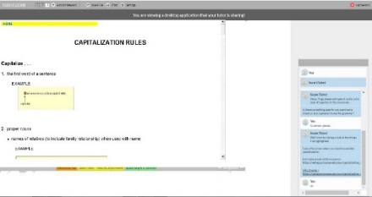
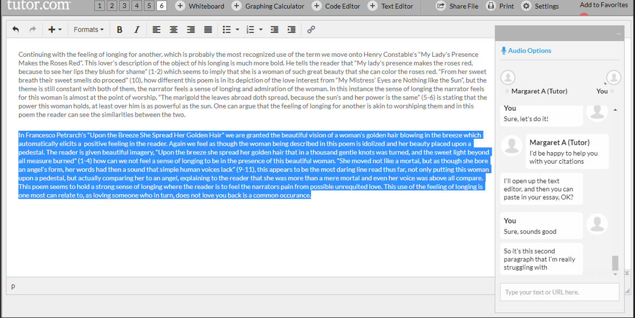
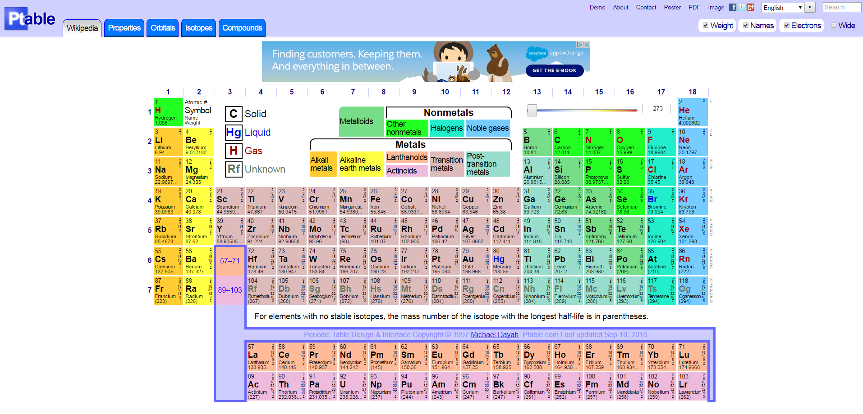
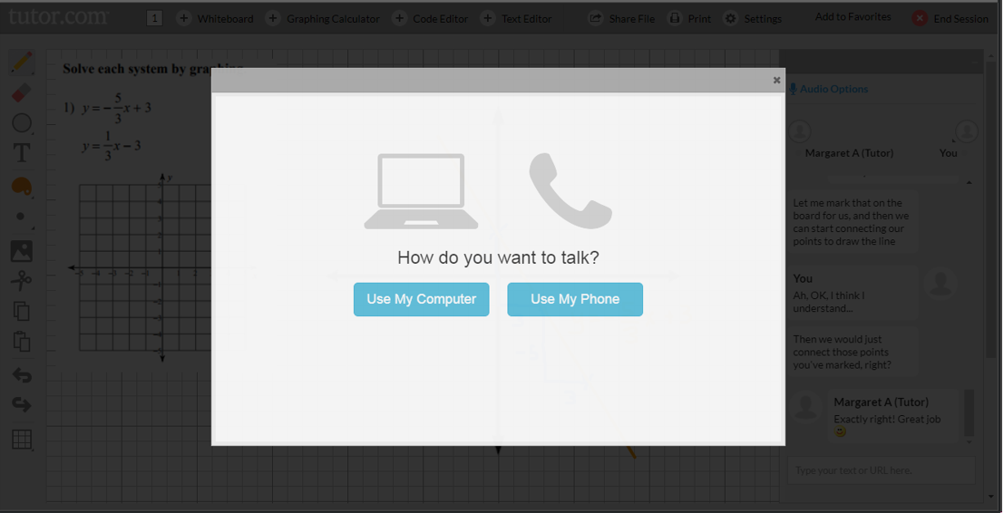
Added in 2017 New Online Classroom Tools
www.tutor.com/Classroom/HTML5/?Practice=1
Chat & Interactive Whiteboard
Shared Application Viewing
Shared Website Viewing
NEW – Two Way Text Editor
12
NEW – Graphing Calculator
NEW – Voice/Audio Option

Slide 13
Patron Experience
Classroom Connection & Chat
Choose your topic.
Choose your subject.
Choose your grade.
Enter your zip code (optional)
Choose your home library/school.
Select voice if you’d like.
Enter your question.
Attach a file, if you’d like.
Click to connect.
www.tutor.com/clientcarelib/la
13

Slide 14
Patron Experience
Voice & Audio Option
Choose computer or phone.
Audio transcript is recorded.
Audio transcript is transcribed to text.
Currently unlimited storage, but may eventually be limited to 12 months.
www.tutor.com/clientcarelib/la
14

Slide 15
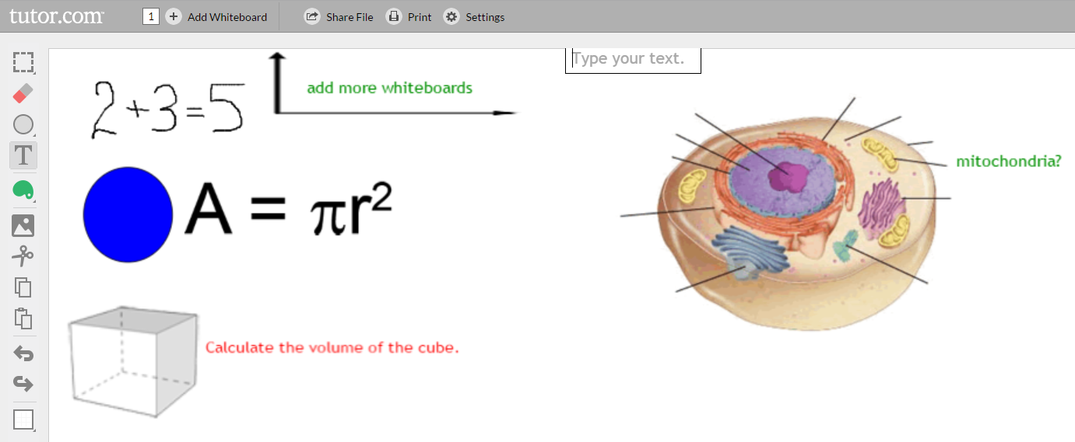
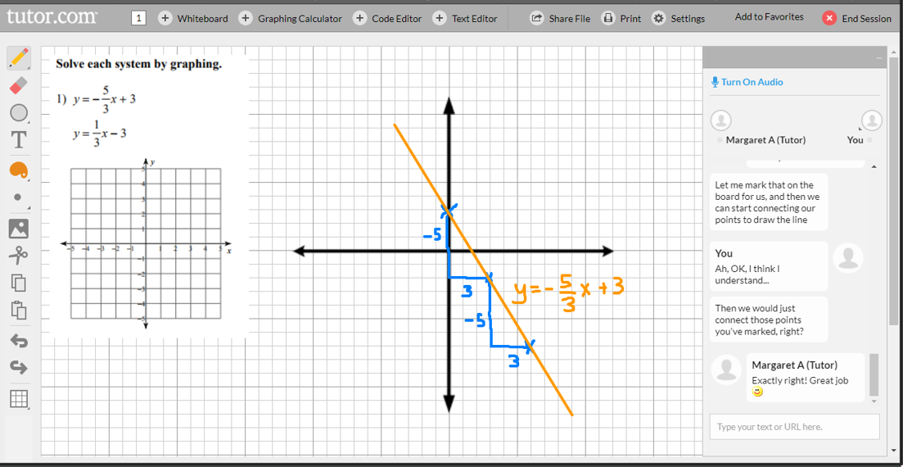
Patron Experience
Interactive Whiteboard
Drawing and writing tools.
Paste or import images.
Change background to graph paper.
Drag & drop shapes & formulas.
Open multiple whiteboard.
www.tutor.com/clientcarelib/la
15

Slide 16
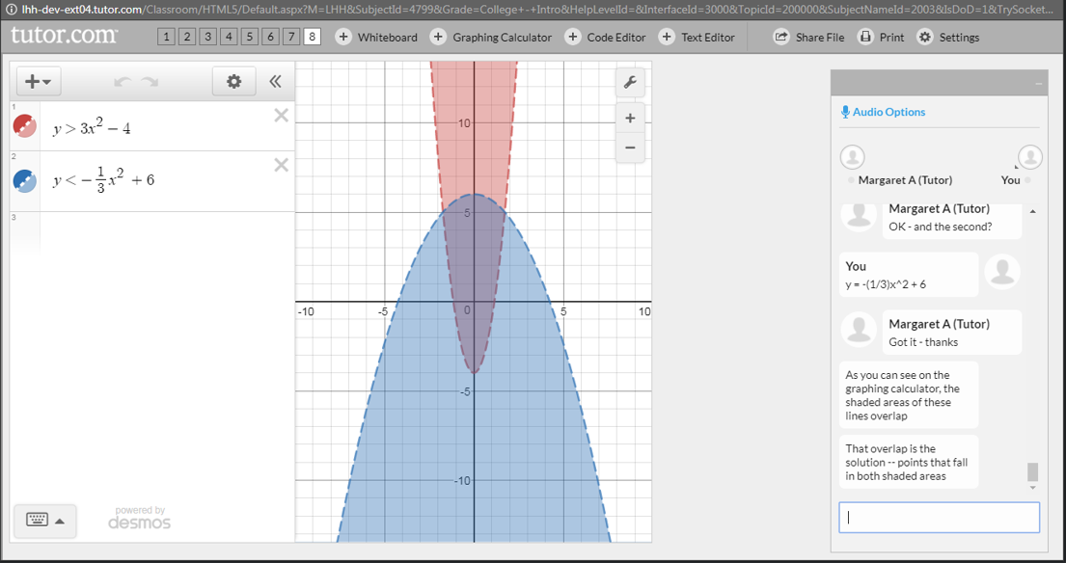
Patron Experience
Web Resource Sharing
Tutors open websites in classroom for shared viewing to supplement the discussion and instruction.
URLs for all shared resources are provided as links in the session transcripts.
NEW!
Available in upper level math and science subjects
Complex equation editor with resulting graphs.
Graphing Calculator
www.tutor.com/clientcarelib/la
16

Slide 17
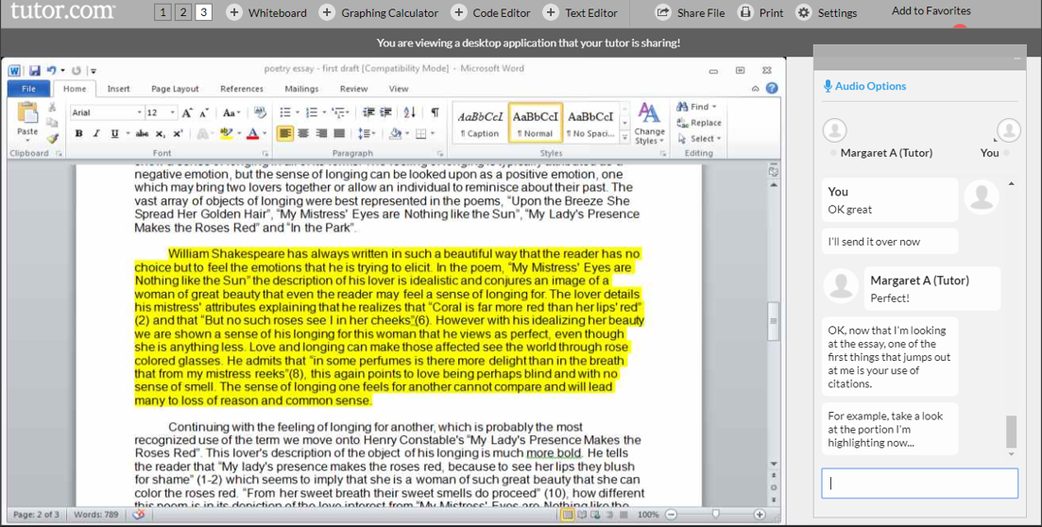
Patron Experience
File Sharing
Word, Excel, PowerPoint, TXT, HTM, HTLM, PDF, JPG, BMP, PNG (1 MB, max)
Tutor shares application so students can see software tools.
Excellent for teaching MS Office.
Replaces copy/paste of text on whiteboard.
Allows both student and tutor to modify the text.
Two-Way Text Editor
NEW!
www.tutor.com/clientcarelib/la
17

Slide 18
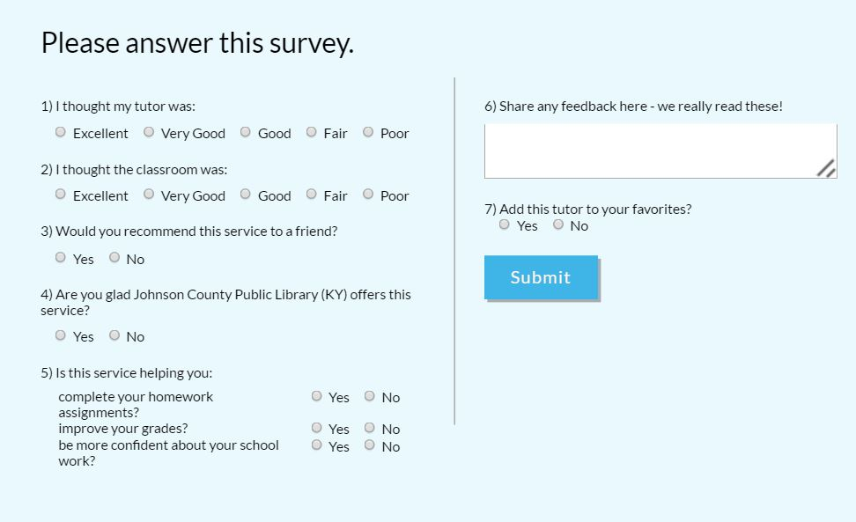
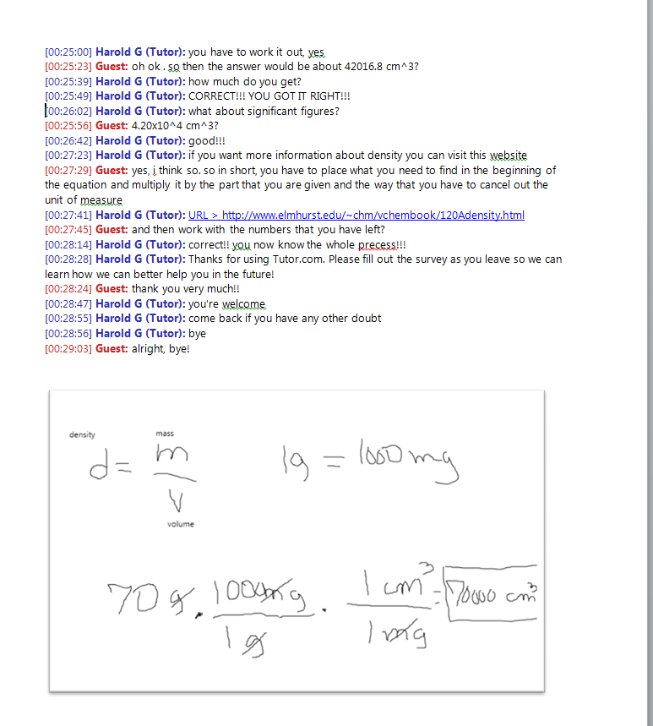
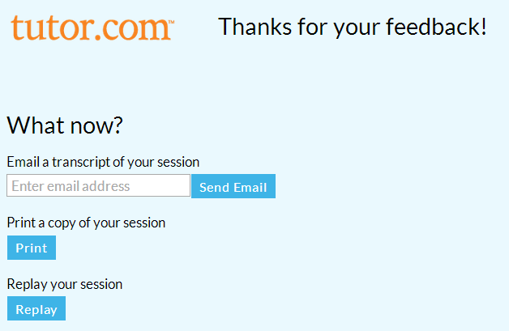
Patron Experience
Post Session Reviews
Post-Session Survey – results in your reports
Transcript delivery options
Email
Print
Replay Video
Transcript includes live links and all whiteboards & tools.
www.tutor.com/clientcarelib/la
18

Slide 19
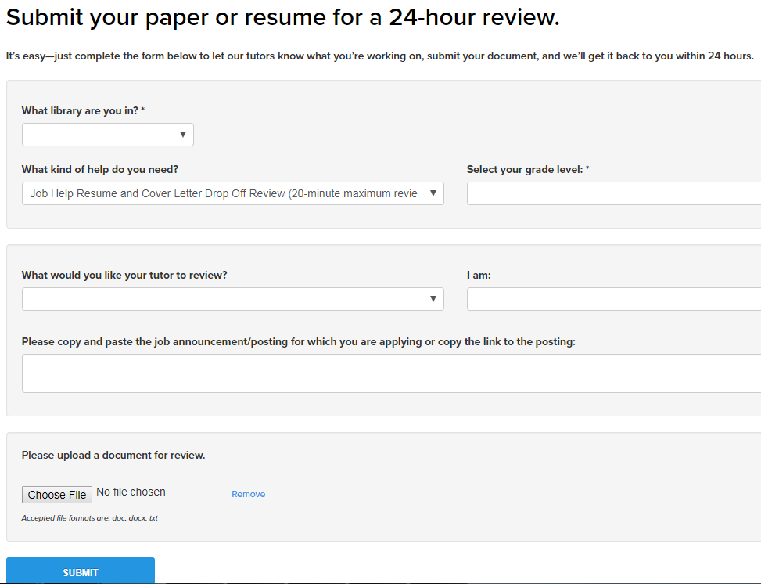
Patron Experience
Drop-Off Essay & Résumé Review
K-12th + intro-college
Adult Learners
Job Seekers
Open 24/7
Turn-Around: ≈5-6 Hours
5,000 Character Maximum
Guidance, Not Editing
(exceptions for résumés)
www.tutor.com/clientcarelib/la
19

Slide 20
Example questions
Grade | Describe Your Assignment
9th Grade | “Persuasive essay, two claims with evidence, and a counter claim.”
12th Grade | “Write journal entries of the beg,middle,end of the book All quiet on western front”
College – Intro Level | “The essay should be about 5 pages long. You must do ONE outside reading and incorporate it into the paper. This is to be a thesis paper, so you should argue for a position--e.g. that voluntary euthanasia should be legal. Or you can make it more specific, e.g. physician assisted suicide but not euthanasia, etc.”
Recent Graduate: Job Seeker | “No specific job announcement/posting. Just need a general review of my resume. Thank you!”
Adult | “Personal statement for family medicine residency. I am mostly concerned about conciseness and flow.”
Job Seeker | “Hi. One of the current desk monitors near my job reccomended I email the Resident safety program directly even though I already applied because supposedly the program stony brook uses is really slow. Do you mind just reading over the email?”
FLI: For Librarians’ Information
www.tutor.com/clientcarelib/la
20

Slide 21
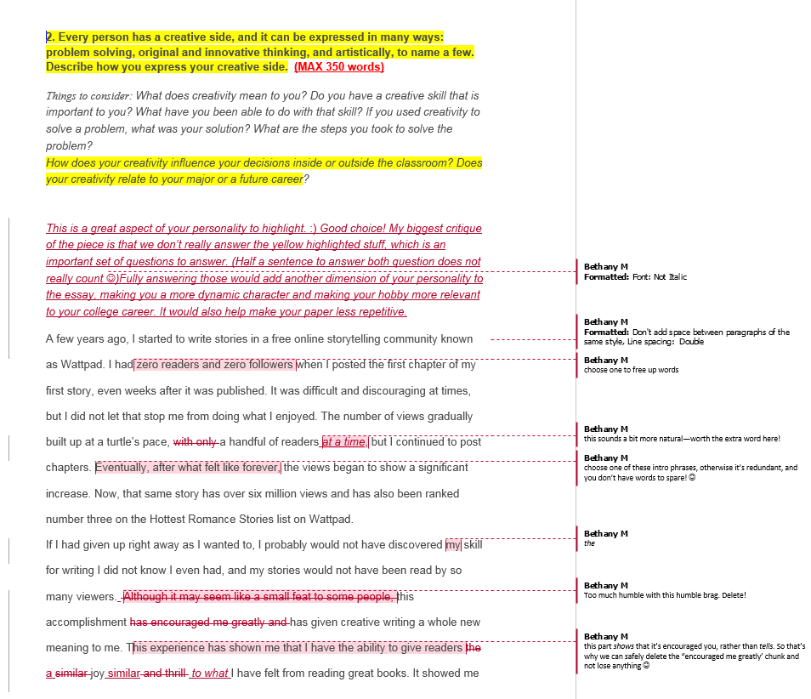
Patron Experience
Summary Feedback Form
Strengths: Great topic! Good Flow!
Weaknesses: We have some places where we can cut words and phrases to give you more space to answer the questions we didn’t really touch on enough from the prompt.
Recommended Next Steps: After you work through these changes, make sure you read the essay out loud to make sure everything is good to go! ☺ Don’t be discouraged– my application essay took 11-12 drafts to be really ready for submission to a highly competitive school. You’re doing a fabulous job, and you’re really close to being finished! :D You got this!!!
www.tutor.com/clientcarelib/la
21

Slide 22
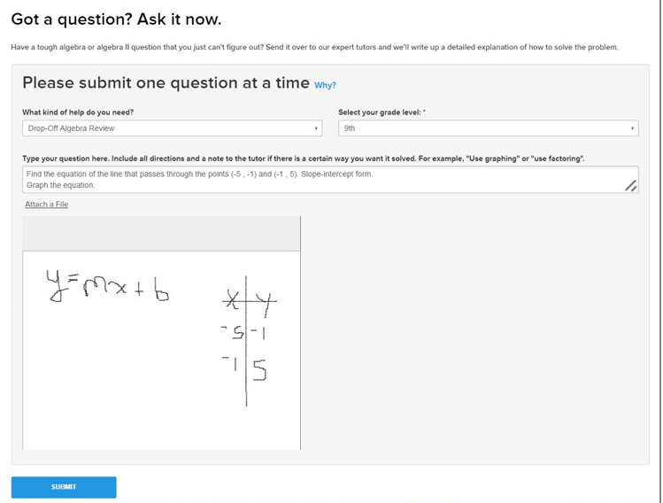
Patron Experience
Drop-Off Math Questions
Middle & High School Math Subjects
Algebra through Calculus
Open for submission during regular tutoring hours.
Turn-Around: ≈12 Hours
Limited to one question per submission
www.tutor.com/clientcarelib/la
22

Slide 23
Example questions
Grade | Describe Your Assignment
9th Grade | “Two planes leave an airport at the same time heading in the same direction. One plan is traveling at 350 mph and the other is traveling at 400mph. How long will it take for the difference between the two planes to be 75 miles?”
10th Grade | “Hi, I'm currently doing this problem on my Solving Quadratic Systems Homework and I don't know how to do it. Please use the quadratic formula for this one and help solve it algebraically. Thank you.”
11th Grade | “I wanted help understanding the e (base of natural logarithms) and the ln for logs.”
12th Grade | “determine the y intercept of the line represented by the given equation -y=7/4x+8/7 I know we have to divide by -1 to get the answer because the teacher said so but I do not understand why we have to divide -1 for this problem, how do I know when to do that?”
College | “Please see attached. I'm confused because when I get to the last step of integrating sin^2(x) again, wouldn't I just be back in a loop of integrating and replacing the answer with the given trig identity?”
FLI: For Librarians’ Information
www.tutor.com/clientcarelib/la
23

Slide 24
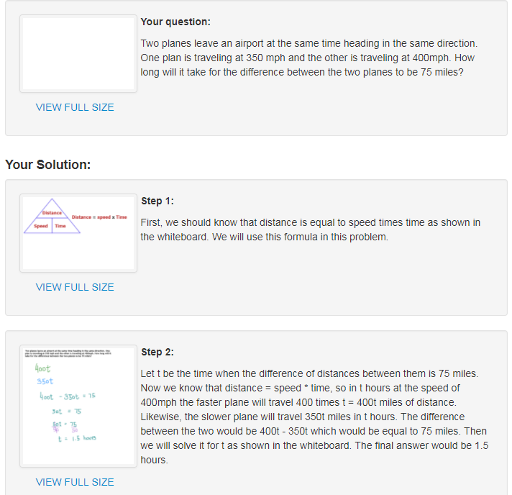
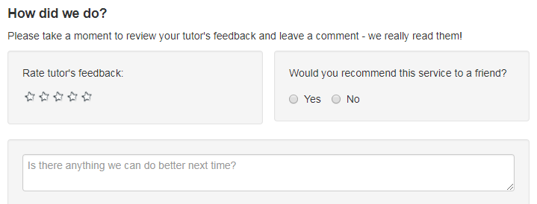
Patron Experience
Step by Step Explanations
Explanation for each step
Neatly drawn whiteboards
Post-response feedback form
Not a substitution for real-time tutoring sessions
Can be helpful as a time-management tool
www.tutor.com/clientcarelib/la
24

Slide 25
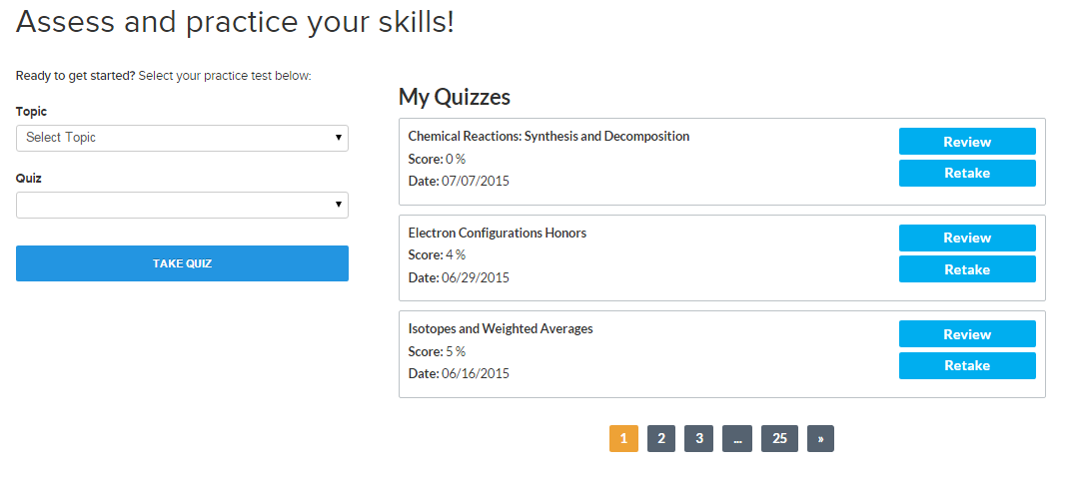
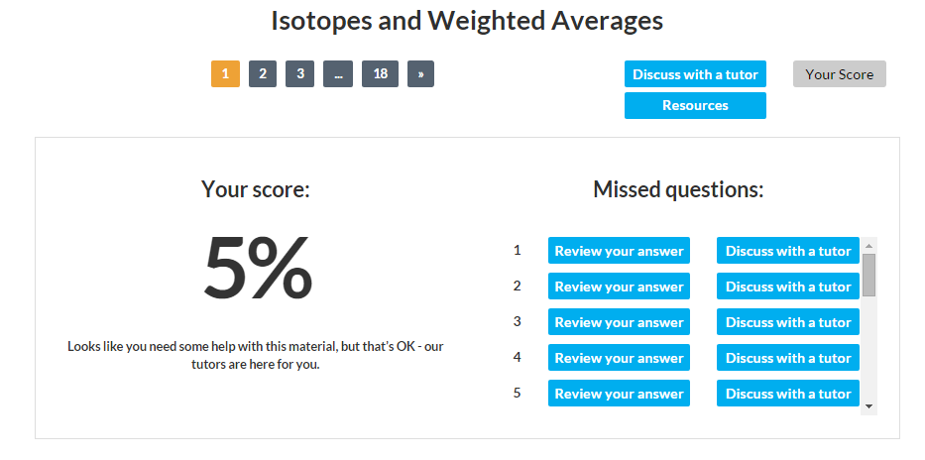
Patron Experience
Practice Quizzes & Skills Drills
High School/End of Chapter
Math Fundamentals
Algebra I
Geometry
Algebra II
Calculus
Biology
Chemistry
Physics
English/Language Arts
www.tutor.com/clientcarelib/la
25

Slide 26
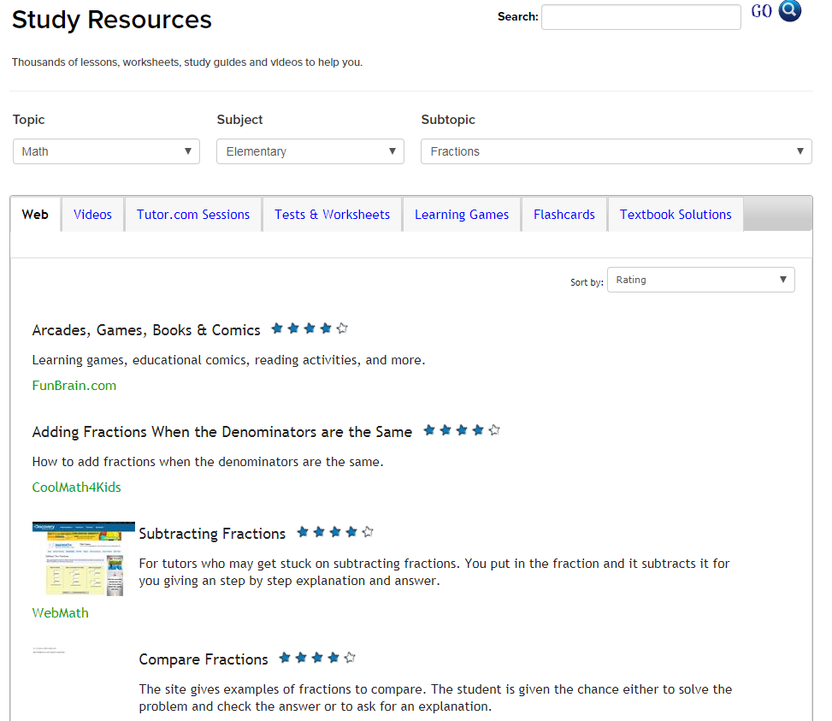
Patron Experience
SkillsCenter™ Resource Library
Study • Test Prep • Job Search
Websites
Videos
Tutor.com Sessions
Sample Tests & Worksheets
Learning Games
Flashcards
Textbook Solutions
www.tutor.com/clientcarelib/la
26

Slide 27
Questions?
Next Up: SAT/ACT Essentials

Slide 28
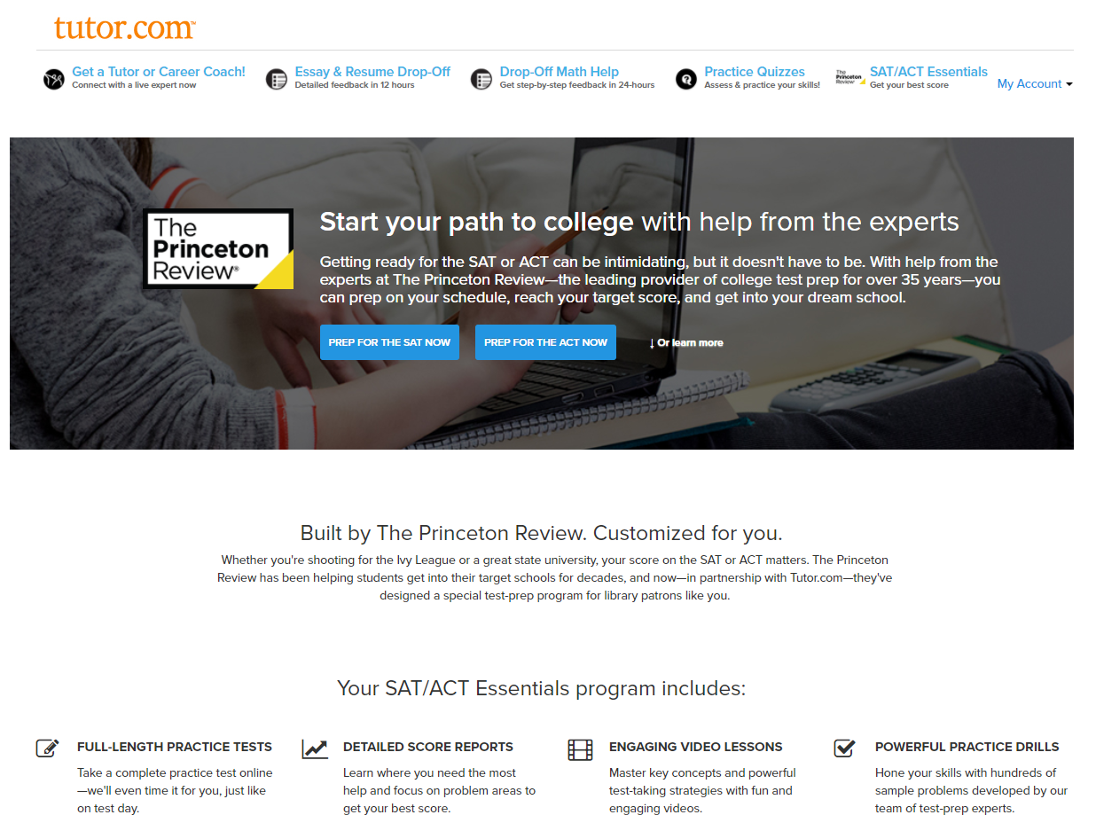
In-library practice test events
Benefits of Offering In-Person
Help students prepare for test day.
Build awareness of Tutor.com.
Provide instruction on using Tutor.com.
Attract new students into the library.
Connect with school guidance counselors.
An excuse to buy doughnuts.
FLI: For Librarians’ Information
www.tutor.com/clientcarelib/la
28

Slide 29
Admissions advice
Taking Both SAT & ACT can be beneficial.
Increase chances of MERIT BASED AID.
Provide more information to admissions counselors.
ACT could, for some schools, replace the SAT Subject Tests.
FLI: For Librarians’ Information
SAT Test Dates
Mar 10 Oct 6
May 5 Nov 3
June 2 Dec 1
Aug 25
ACT Test Dates
Feb 10 Sep 8
Apr 14 Oct 27
June 9 Dec 8
July 14
Early Decision/Early Action
Applications generally due on or around Nov. 1, Nov 15, Dec. 1 or Dec 15, depending on school.
29

Slide 30
Pre-event planning
In-Library Practice Tests
Choose ACT or SAT. ACT is required in Louisiana for high school graduation. Tuition assistance is available to students for Louisiana higher education institutions if the student scores at least a 21. Consider offering an SAT practice test once or twice a year for those students considering out-of-state or private schools.
Choose your space: computer lab or classroom style? Capacity? Quiet Environment?
You will need the room for a minimum of 4 hours. For prep time, it is preferable to book it for five hours.
Print Materials if you are using printed booklets instead of computer-based testing.
SAT Test Booklet & Bubble Sheet
ACT Test Booklet & Bubble Sheet
Do a dry-run to get a “Score Report” and understand the process
FLI: For Librarians’ Information

Slide 31
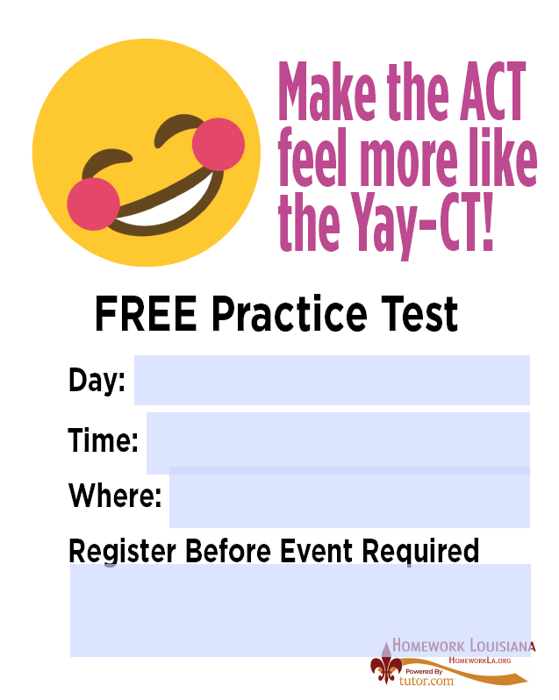
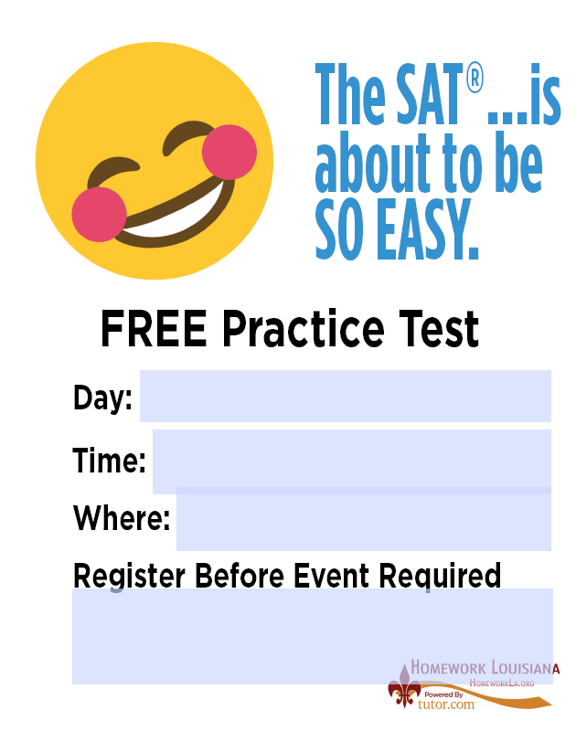
advertising
www.tutor.com/clientcarelib/la
Customizable Flyers Social Media
FLI: For Librarians’ Information

Slide 32
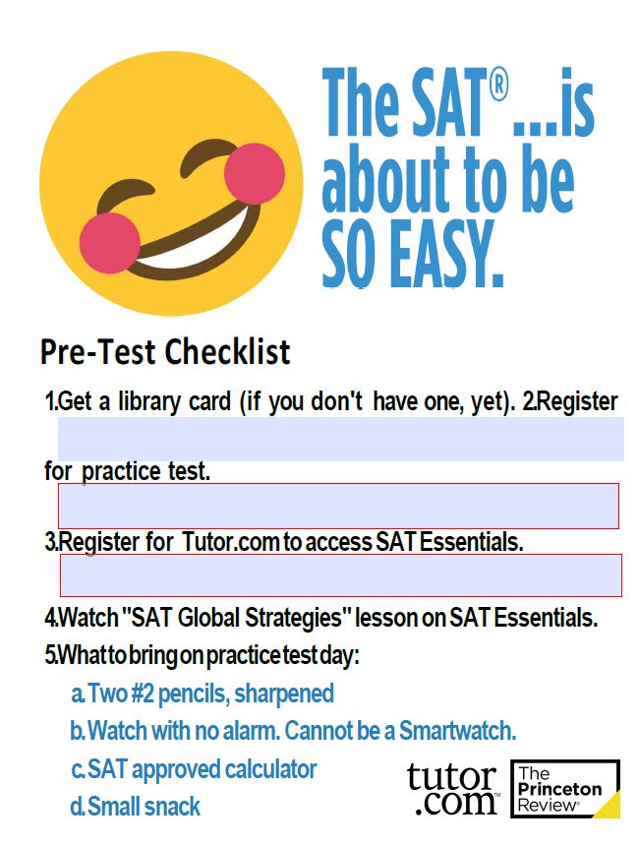
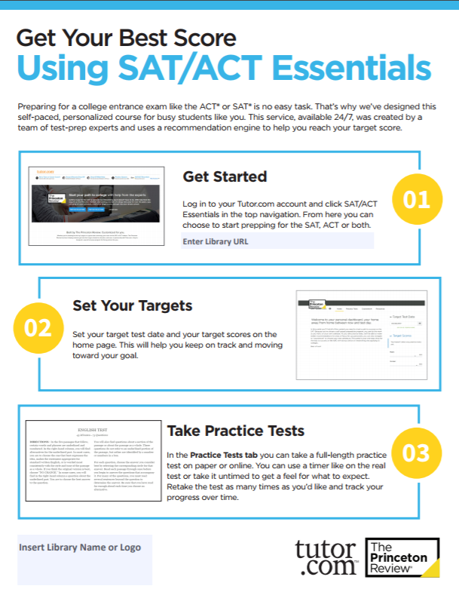
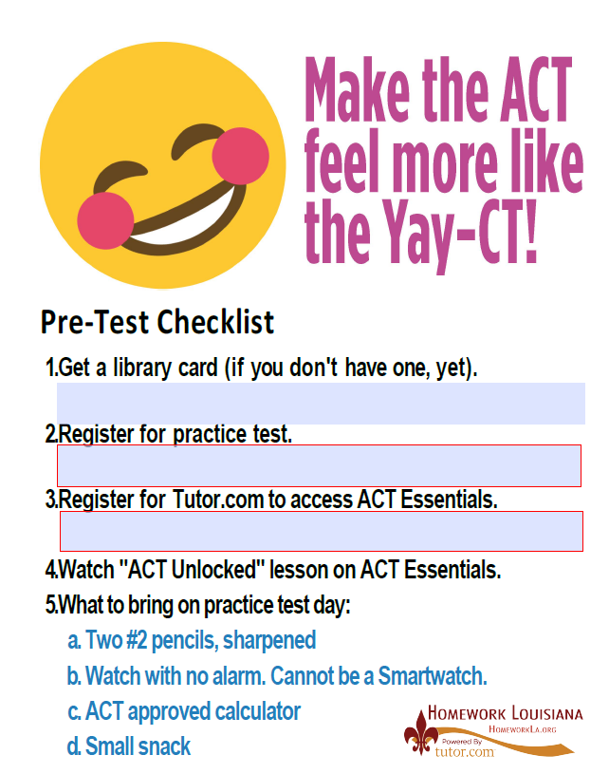
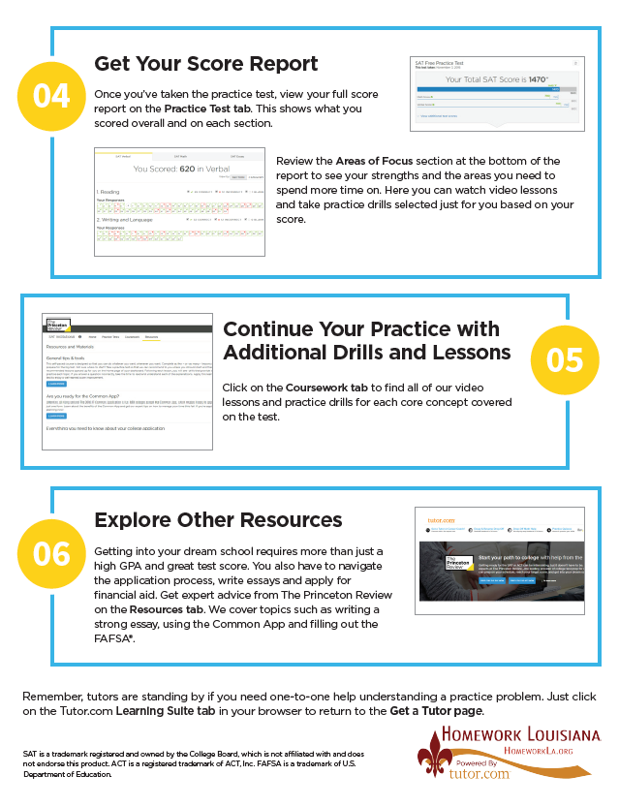
Pre-Test Packet
Pre-Test Checklist and “How To” Guide
Consider printing and providing a copy of the test prep books you have available in your library as part of the pre-event package so students know there are resources available that are not online.
FLI: For Librarians’ Information
Be prepared for students that have not taken these steps. You’ll need extra time at the beginning to get a few of them setup with Tutor.com accounts.
FYI: Official “What to Bring” from College Board and ACT, Inc.
https://collegereadiness.collegeboard.org/sat/taking-the-test/test-day-checklist
https://www.act.org/content/act/en/products-and-services/the-act/test-day.html

Slide 33
TEST day
Provide refreshments. The tests do allow for “break time.”
If using computers, have computers already on the Tutor.com authentication page.
Spend 10-15 minutes showing them the Tutor.com service and explaining how to use their Score Reports & Coursework to improve.
If using printed tests and bubble sheets, be sure to show them how to enter their answers into the Essentials program. Tell them EXACTLY which practice test they are taking.
When it is time to start, launch the online proctor. Even if using computers to take the test, the online proctor simulates the test day environment so they can learn pacing.
FLI: For Librarians’ Information

Slide 34
Patron Experience
SAT/ACT Essentials
The Princeton Review’s Self-Paced Prep Course
Practice Tests for ACT & SAT
Detailed Score Report
Video Lessons
Practice Drills
Admissions Advice
www.tutor.com/clientcarelib/la
34

Slide 35
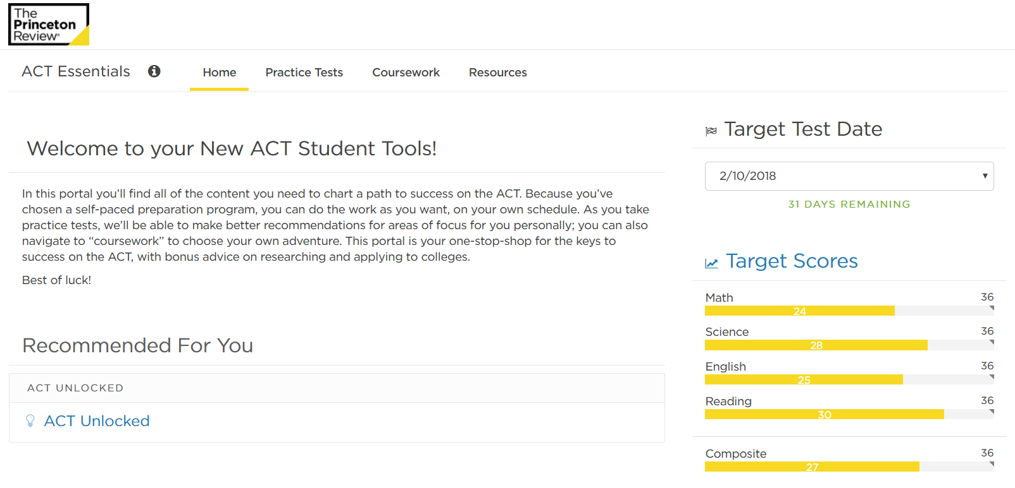
Patron Experience
Navigation Tabs
Essentials’ Navigation
Home Tab
Set Targets
Access Strategies Module
Practice Tests
1 Practice ACT Test
9 Practice SAT Tests
Download Bubble Sheets
Online Proctor
Coursework
Video Lessons
Practice Drills
Resources
College Application Advice
Recommendations
Set Targets
www.tutor.com/clientcarelib/la
35

Slide 36
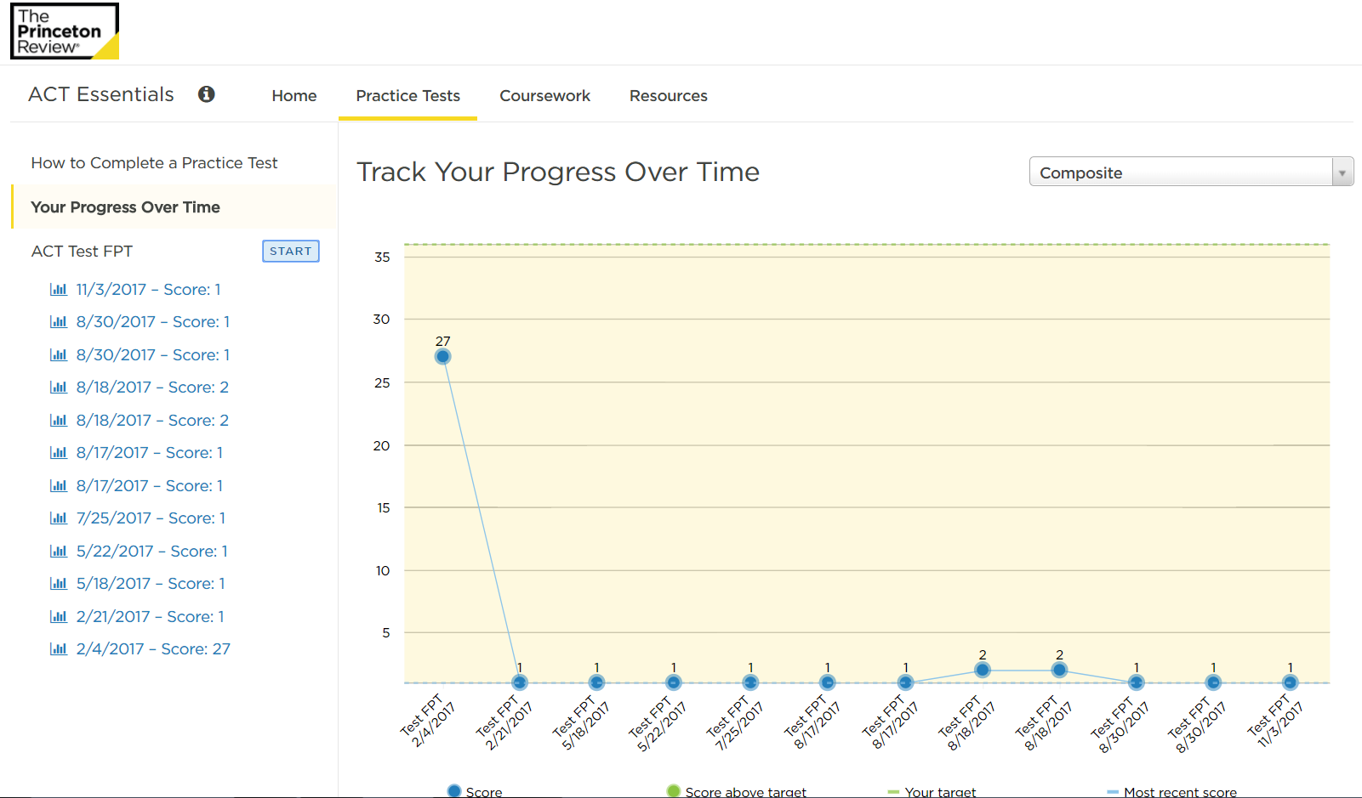
Patron Experience
Score History
Practice Test Options
Click “Start”
Choose Online or Download Tests & Sheet
Launch Online Proctor
Resume Paused Tests
Scores Over Time
Graph of results
Previous Score Reports
Click to access score reports
Previous Scores
36
www.tutor.com/clientcarelib/la
36

Slide 37
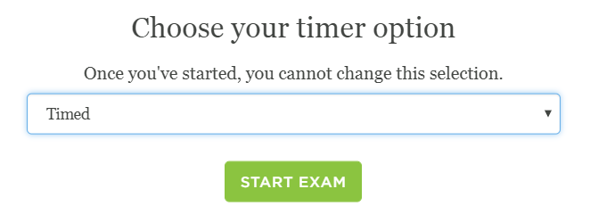
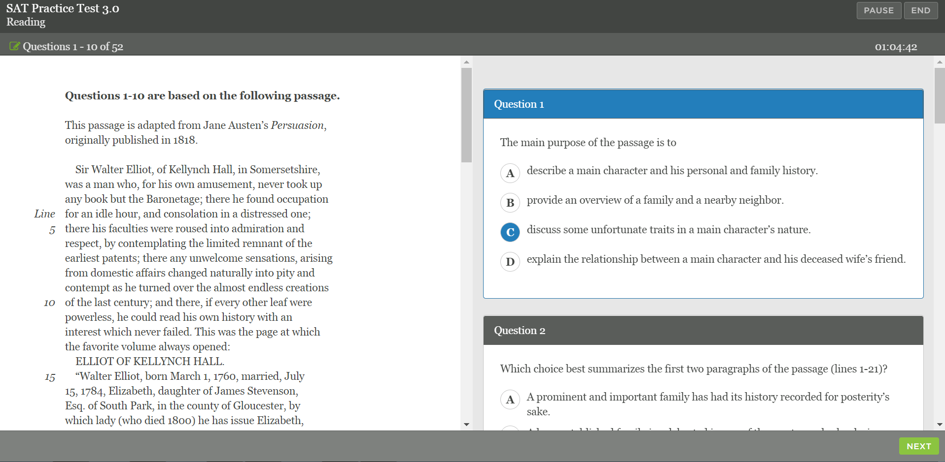
Patron Experience
Practice Tests
Choose Time Allotment
Timed (just like on test day)
1.5x
2x
Untimed
Navigating Test
Pause & End Button – Top Right
Timer Under Pause/End
Next Button – Bottom Right
37
www.tutor.com/clientcarelib/la
37

Slide 38
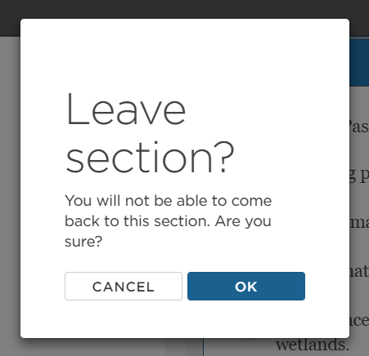
ACT Sections
sat Sections
3 Hours 50 Minutes
45 Minutes: English
60 Minutes: Math
10 Minutes: Break
35 Minutes: Reading
35 Minutes: Science
5 Minutes: Break
40 Minutes: Essay
3 Hours 57 Minutes
55 Minutes: Reading
10 Minutes: Break
35 Minutes: Writing & Language
25 Minutes: Math – No Calc.
5 Minutes: Break
55 Minutes: Math – Calculator
2 Minutes: Break
50 Minutes: Essay
38
www.tutor.com/clientcarelib/la
38

Slide 39
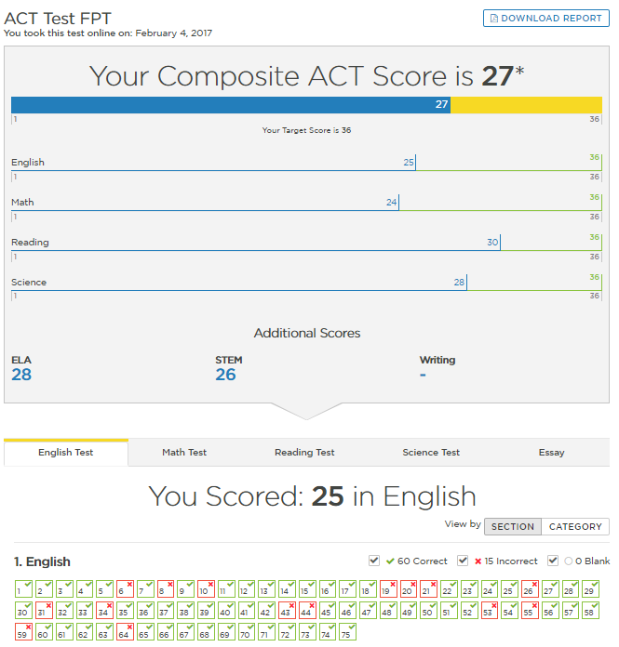
Patron Experience
Score Report Sections
Composite Score
Total
By Section
Compared to Target
Section Score
By Section
By Category
Drill Down Into Questions
39
www.tutor.com/clientcarelib/la
39

Slide 40
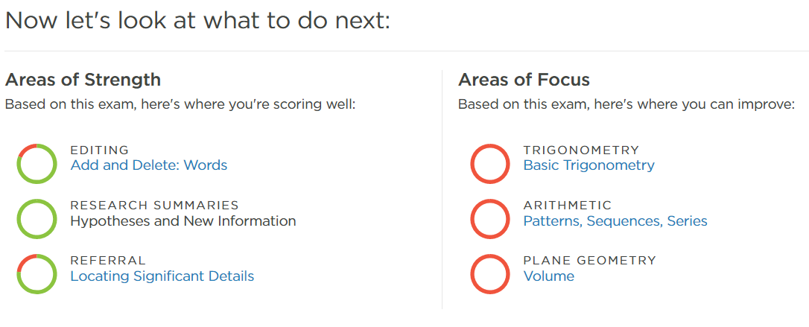
Patron Experience
Score Report: Next Steps
Question & Category
Correct Answer Shown
Explanation Given
Concept Categorized
Areas of Focus
Ordered by Priority
Click for Coursework
40
www.tutor.com/clientcarelib/la
40

Slide 41
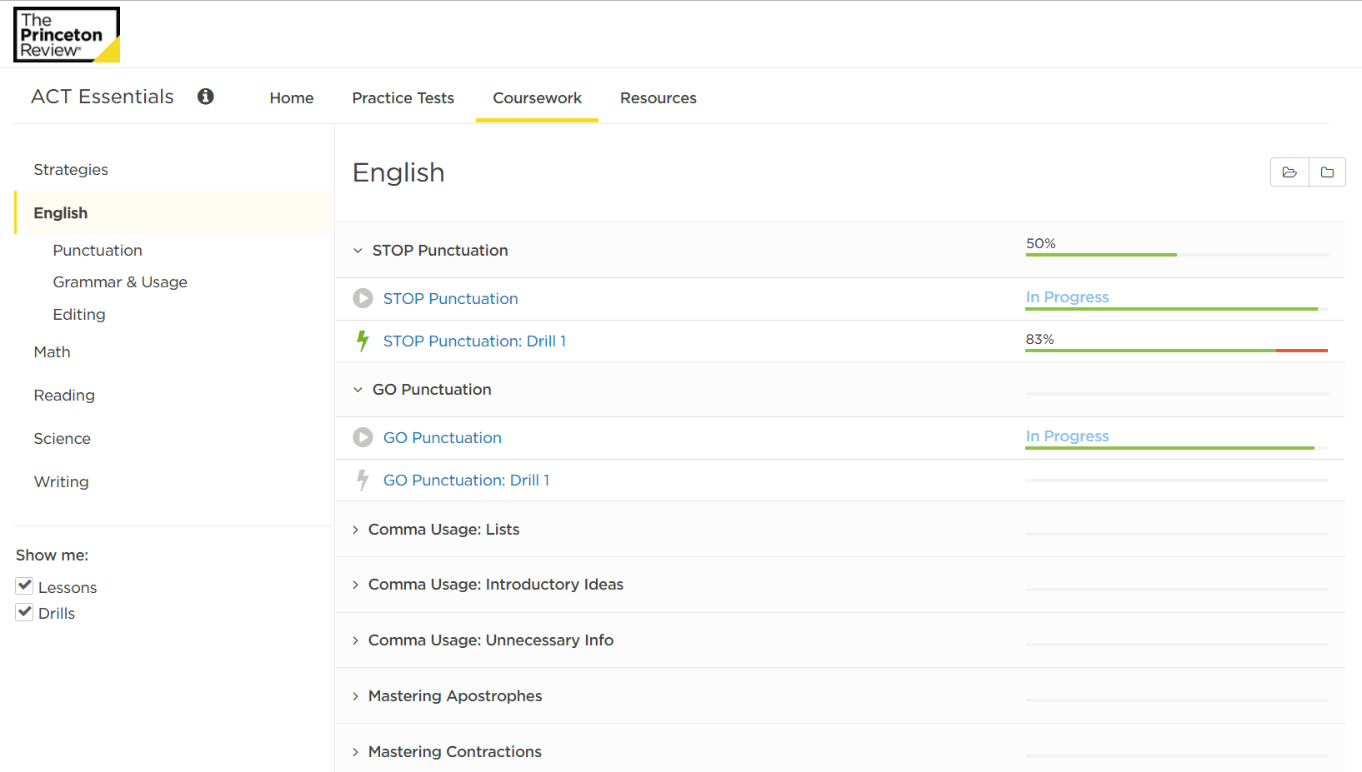
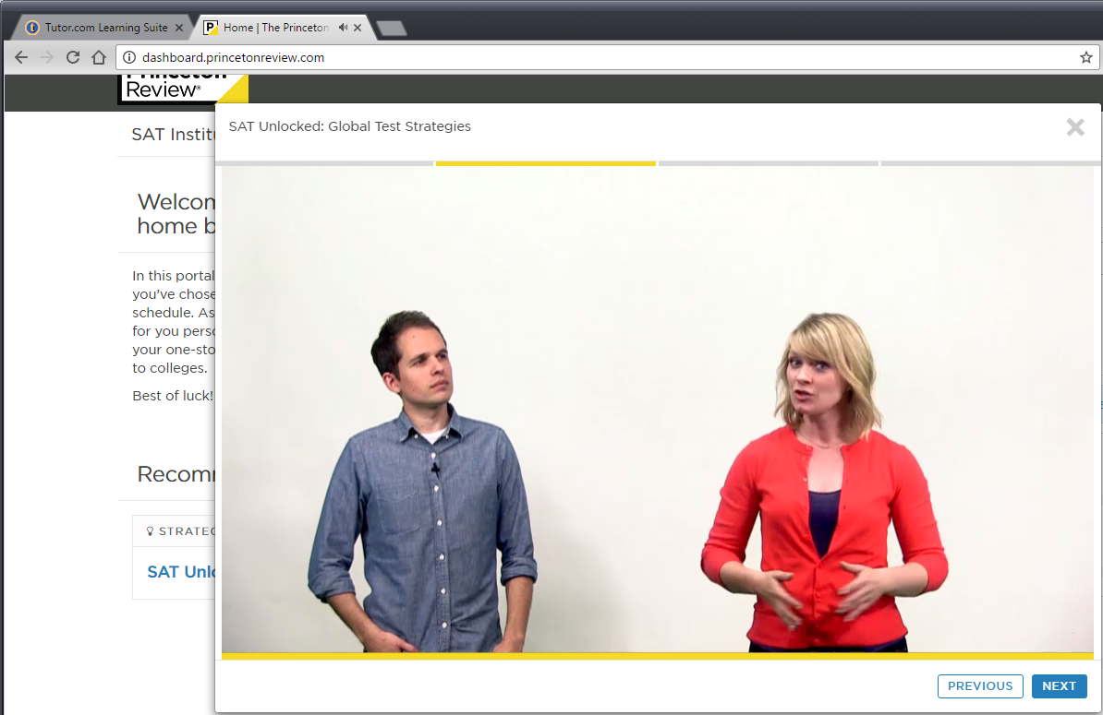
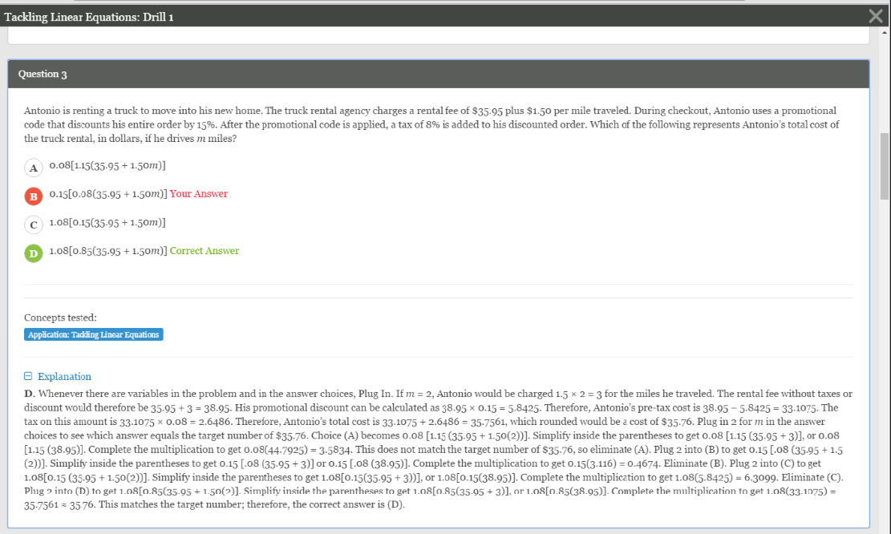
Progress through lessons
Patron Experience
Coursework Tab
By Section & Category
90 ACT Lessons
90 SAT Lessons
Video & Drill for Each
Videos & Drills
Tutor.com Browser Tab
Connect With a Tutor
Flip Back to Tutor.com tab in your browser for help from an on-demand, subject-matter expert if you don’t understand any questions or concepts from the video lessons or practice drills.
Tutor.com Tab in Browser
41
www.tutor.com/clientcarelib/la
41

Slide 42
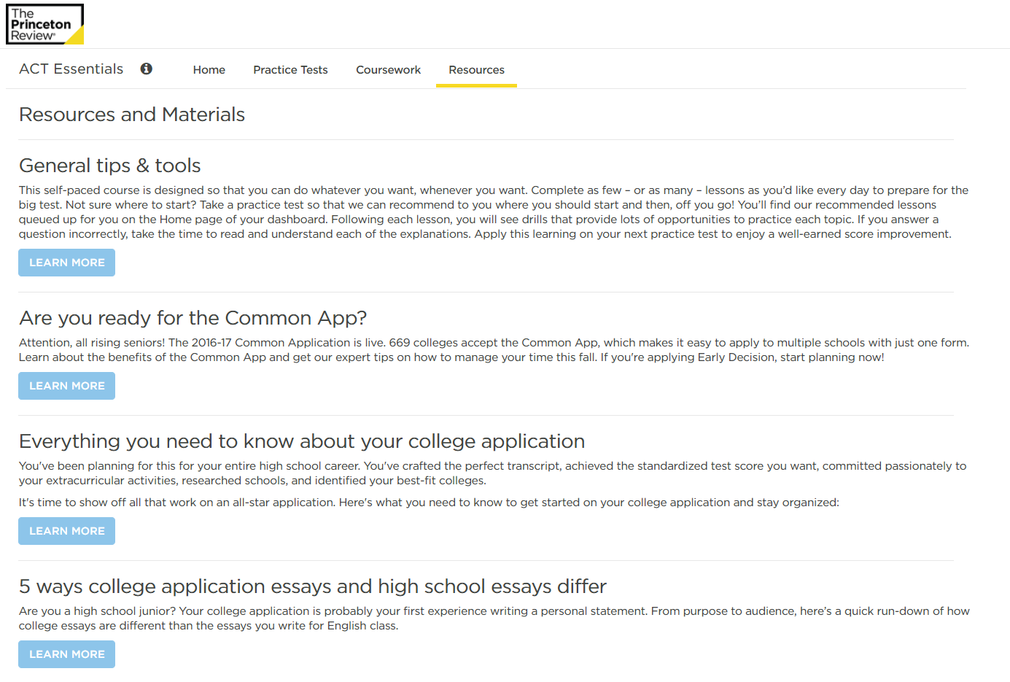
Patron Experience
Resources Tab
The Common App
Applications
Writing Your Essays
Choosing Your School
Choosing Your Major
Financial Aid
Test Strategies
GPA & High School Classes
42
www.tutor.com/clientcarelib/la
42

Slide 43
Questions?
Next Up: Promotion

Slide 44
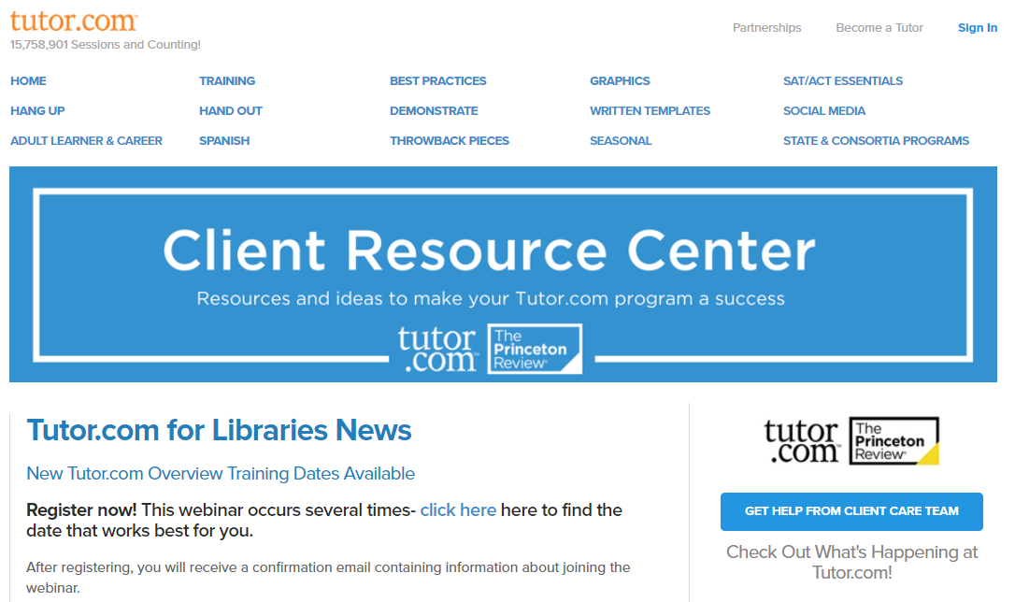
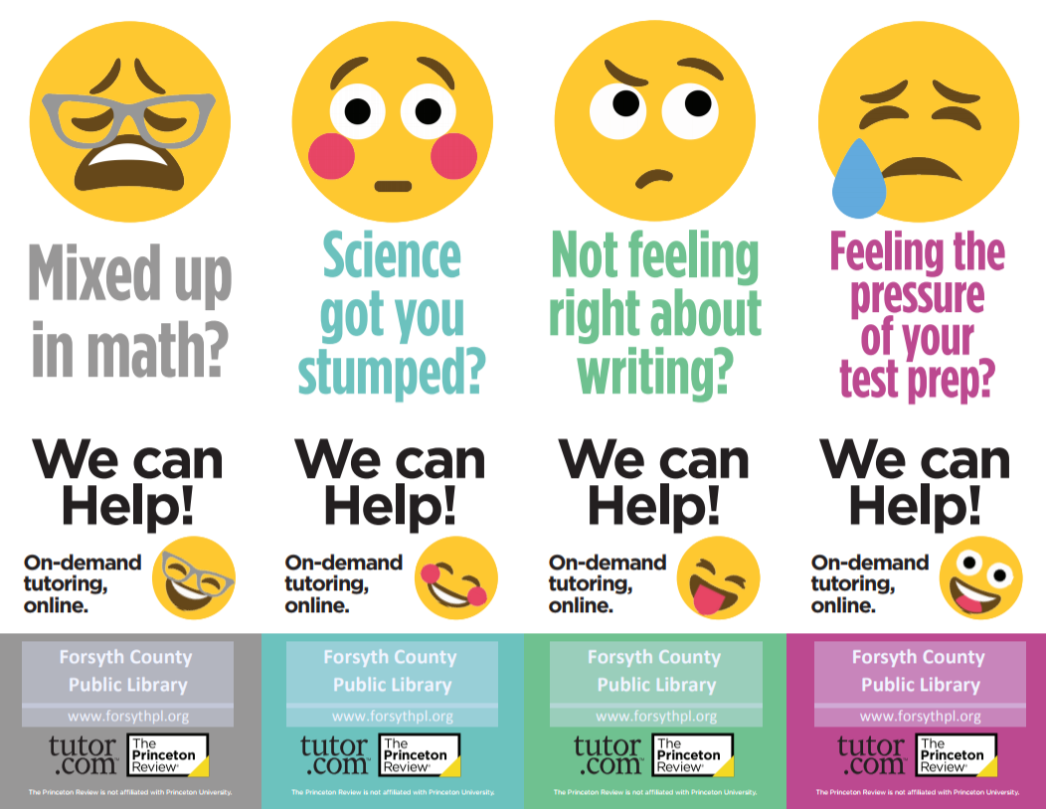
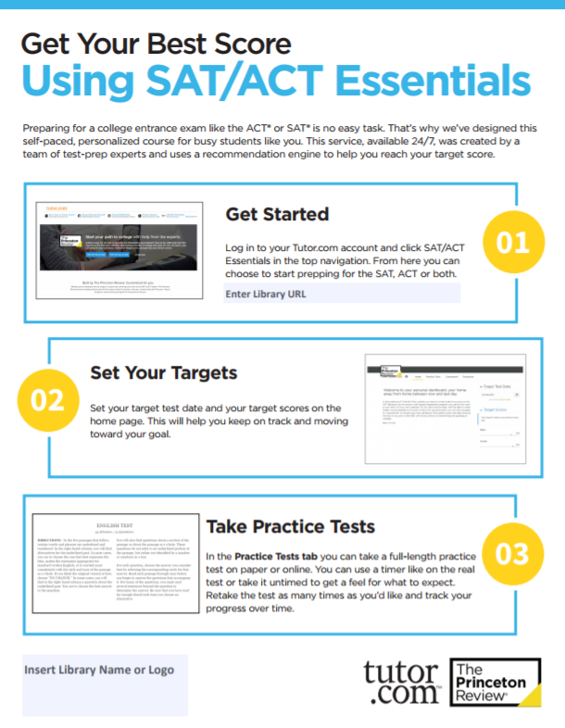
Client Resource Center
FLI: For Librarians’ Information
www.tutor.com/clientcarelib/la
44
Notes:
Hello and welcome. My name is Alexis Bauserman and I lead the college counseling team at The Princeton Review. We work directly with high school students as they research, plan for and apply to college. I am excited to be talking with you this afternoon. Let me start by sharing a bit of my background. I am an educator at heart and I truly love working with students as they navigate the transition from high school to college. For many students, this transition is a big part of their larger transition to adulthood and independence. For that reason, it’s a both a challenging time for families and a really exciting time. I started my career working in the admission office of a selective liberal arts college. I traveled around the country, visiting high schools and recruiting talented students. I then read their applications and helped make admission decisions as part of the Decision Committee. I later moved to “the other side of the desk,” as we say in the admission world, to work a college counselor at a private high school in Austin, TX, which is where I now reside. I have both an MBA and a Masters of Public Affairs from the University of Texas and chose this specific combination of degrees because of my belief that collaboration between business and government is one of the most exciting ways to create scalable solutions in education. That is exactly what I spend my days doing at TPR and I count myself lucky to be able to serve students every day.
Given my audience today, I also wanted to share that I am an avid reader with great respect for the important work you do!
But, more to the point,
Today, I am here to provide an overview of the college admission process and offer some insight into how you might serve patrons who are navigating this process.

Slide 45
www.tutor.com/clientcarelib/la
Month | Theme Ideas | In-Library | In-Schools | In Community | Electronic
Jan | New School Year Resolutions! Spring college admissions activities | Make Resolution Mobiles. Have students set resolutions about school. Show them Tutor.com to help keep those resolutions. | Restock flyers, brochures, etc. at the schools. Outreach to guidance counselors, especially with SAT/ACT Essentials information for spring tests. | Work with the local community college or BOCES to inform HSE/TASC takers of tutoring opportunities. | Focus on spring test dates for SAT/ACT. Post reminders to file FAFSA. “Dreaming of College” social media post. “Make Tutor.com part of your New Year’s Resolution.”
Feb | Library Lovers’ Month. Standardized Test Prep Starting. Random Acts of Kindness Week. | Electronic Resources “Speed Dating” for teens. Setup multiple computers (if available) with different resources and give teens 2-3 minutes at each station to explore. | Distribute “Top 10 Things Teachers Should Know” about Tutor.com via email and include a note about how Tutor.com tutors align their techniques with Common Core. | Reach out to church/synagogue/mosque youth leaders. If they focus their ministry on serving the whole person, they may touch on areas outside of religion. “How the library can help you destress.” | Tweet “I LOVE TUTOR.COM” student comments or “My tutor was so nice.” Guest blog post from a teen that tried Tutor.com and “loves” it.
Mar | “Luck” (St. Patrick’s Day). 3rd Quarter Report Cards coming soon. Standardized Test season begins. | With science testing in early April, consider a month of STEM programming in April. You can use Tutor.com science packets if you don’t plan to use them in the summer. Hang up “Science got you stumped” flyers. | Focus on English teachers. Send them flyers for WriteTutor and encourage them to offer extra credit to students using Tutor.com before handing in big papers. | Boys and Girls Club often have in-person tutoring or homework help programs. Drop off some brochures about Tutor.com so they can provide their members with supplemental assistance outside of regular program hours. | Instagram “Lucky You” graphic. “Still too cold to go outside? Go ahead. Get tutoring help from the comfort of your couch.” Post the pie graph of your usage by subjects on Pi day.
FLI: For Librarians’ Information
www.tutor.com/clientcarelib/la
45

Slide 46
www.tutor.com/clientcarelib/la
Month | Theme Ideas | In-Library | In-Schools | In Community | Electronic
Apr | Spring sports. Testing continues. Last quarter begins. | “It’s your lucky day” table setup. Rotate resources through the week. Put out brochures or bookmarks and an iPad or laptop for demos. | Outreach to coaches & Advanced Placement teachers. Consider advertising at high school sporting events (banner sign on baseball fence?). | Hang flyers on community bulletin boards (restaurants, grocery stores, laundromats) or focus on workforce development. Visit local WD offices with information. | “Working on a paper?” Instagram/facebook/twitter post. Reuse “Get in the game” posts. “Is bedtime prime study time?” targets the upper level high school students that are stressed with end of year testing and college apps.
May | AP® Tests. 4-8 Science Tests. National Math Education Month | Raffle: patrons submit math sessions for a drawing at end of month. | Teachers’ Appreciation Week and School Principals’ Day. Send out an email inviting teachers and principals to a “Pop In” night (popcorn & demos) or a Demos & Donuts morning. | Educate local youth organizations that see a lot of kids over the summer about library programs and Tutor.com. They YMCA, S.T.R.O.N.G., Big Brothers Big Sisters, etc. | Post challenging math questions on social media with a link to your Tutor.com program to celebrate National Math Education Month.
Jun | Finals/Regents, end of year. Finish strong. | Test Prep & Writing flyers throughout the teen area. | With summer reading at the front of all librarians’ minds, just focus on pre-scheduling social media posts for June so you don’t have to think about promoting Tutor.com during your busy summer reading season. |  | Year end push on social media. Post about: Don’t give up. The end is in sight. Study for finals. Perfect your paper. Ace the ACT.
FLI: For Librarians’ Information
www.tutor.com/clientcarelib/la
46

Slide 47
www.tutor.com/clientcarelib/la
Month | Theme Ideas | In-Library | In-Schools | In Community | Electronic
Jul | Summer STEM Packets. Planning Time | Use Tutor.com math and science packets for the summer to help keep students engaged with the program even when school is “out.”
Aug | Starting Strong! Gearing up for a great year! | B2S party or Program for parents | Attend B2S nights. Email to principals/teachers. | Pitch news article to local media about library resources for school. | Highlight on website. Blog post. “Keep calm & connect” post on FB, Instagram, Twitter
Sep | Library Card Sign-Up (LCSU)! | Provide program cards or Tutor.com branded library card holders with every new library card. | ConnectEd (or similar) initiative. Outreach to school librarian/media specialist. PTA meetings. (Top 10 Things Parents Should Know) | A library card can save you, $x every year. Get one today! Pitch to Chamber of Commerce members as an employee perk. “We’ll come to your place of business to distribute applications.” | “When you need help, it’s there” as part of a larger LCSU push on social. Email/newsletter article listing benefits of library membership they might not be aware of (Tutor.com).
Oct | Fall sports, college admissions, 1st semester projects, looming holidays | Host a college night at library and promote Essentials as well as essay writing tutors | Reach out to coaches. Athletes needing help to stay academically eligible can use Tutor.com after practice. | Job seekers applying for seasonal jobs for extra holiday cash can use Tutor.com’s Job Search Center for help. | “Get in the Game” social media posts. Blog post for teens on time management.
Nov | Report Cards. Thanksgiving. | Put speech bubbles with comments of “Thanks to Tutor.com” around the teen area or on top of computer monitors. | Brochures for teachers in faculty rooms, offices, and school libraries. | Outreach to homeless shelters. As the weather gets colder and holidays come around, they see more visitors. Kids are homeless, too. ☹ | “Regretting your report card? Raise your grades with Tutor.com!” social media. Also, post post-session comments of “Thanks.”
Dec | Planning Time | Dec. is a slower month for Tutor.com so instead of trying to promote usage this month, use this time to plan your promotions for the second half of the school year.
FLI: For Librarians’ Information
www.tutor.com/clientcarelib/la
47

Slide 48
Questions?
Client Care Team
Susan Del Rosario
Susan.DelRosario@tutor.com
(920) 327-2859
Joann Claspill
Client Services Manager
Joann.Claspill@tutor.com
Dave Wills
Director, Library Partners
David.wills@tutor.com

